Slide 1
How to use acquisitions units to acquire for and receive for specific libraries.
Yoel Kortick
Senior Librarian

Slide 2

Introduction
Scope of the staff user role "Purchasing Operator"
Relationships of type "Acquiring For"
Acquisitions Department Served Libraries and Operators
Acquisitions Department Served Libraries and Operators – Example 1
Acquisitions Department Served Libraries and Operators – Example 2
Agenda

Slide 3
Introduction

Slide 4
Introduction
It is possible to define that certain libraries will be able to
  Acquire for other libraries
  Receive inventory for other libraries
This is sometimes referred to as a "Library Unit", an "Acquisitions Unit" or an "Acquisitions Service Unit".
This presentation will briefly explain how this done.

Slide 5
Introduction
In general, these are the key elements:
  The "Acquire for" library relations determine which POL Owner Library may acquire inventory for which other libraries
  The "Served Libraries" of the Acquisitions Department determine which libraries' inventory may be received while at that Acquisitions Department.

Slide 6
Scope of the staff user role "Purchasing Operator"

Slide 7
Scope of the staff user role "Purchasing Operator"
The scope of the staff user role "Purchasing Operator" or "Purchasing Manager" determines which libraries can be chosen by the staff user as the POL Owner Library.
Note: For the remainder of this presentation, we will show and discuss the "Purchasing Operator", but it applies also for roles "Purchasing Manager" and "Rialto Purchaser".

Slide 8
Scope of the staff user role "Purchasing Operator"
If the scope of the role "Purchasing Operator" is the institution, then any library may be chosen as the POL owner.
If the scope of the role "Purchasing Operator" is a specific library, then only that specific library may be chosen as the POL owner.
One staff user may have multiple occurrences of the role "Purchasing Operator" and each time it may have a different scope.
Note: The POL Owner library can only be the library which is the scope of the Purchasing Operator of the staff user. The staff user will not be able to choose a POL Owner library which is not the scope of his or her Purchasing Operator role.

Slide 9
Scope of the staff user role "Purchasing Operator"
We will now look at examples of different staff users with different scopes for role "Purchasing Operator"
Staff user Sarah Khan has role Purchasing Operator for Main Library. She can therefore make the POL Owning Library only be Main Library
Staff user Maya Ali has role Purchasing Operator for Law Library. She can therefore make the POL Owning Library only be Law Library
Staff user Mary Ann Barlow has Purchasing Operator for both the Law Library and the Main Library. She can therefore make the POL Owning Library only be Law Library or Main Library
Staff user Niki Karimi has Purchasing Operator for the entire institution "Alma University". She can therefore make the POL Owning Library only be any library

Slide 10
Scope of the staff user role "Purchasing Operator"
For example:
Staff user Sarah Khan has role Purchasing Operator for Main Library:

Slide 11
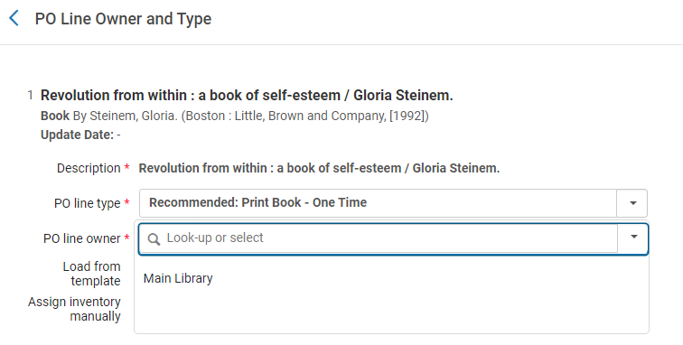
Scope of the staff user role "Purchasing Operator"
This is what staff user Sarah Khan can choose as POL Owner (only libraries that match her Purchasing Operator scope):

Slide 12
Scope of the staff user role "Purchasing Operator"
For example:
Staff user Maya Ali has role Purchasing Operator for Law Library:

Slide 13
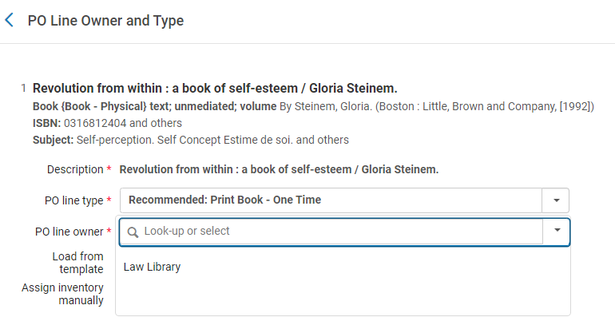
Scope of the staff user role "Purchasing Operator"
This is what staff user Maya Ali can choose as POL Owner (only libraries that match her Purchasing Operator scope):

Slide 14

Scope of the staff user role "Purchasing Operator"
For example:
Staff user Mary Ann Barlow has Purchasing Operator for both the Law Library and the Main Library:

Slide 15
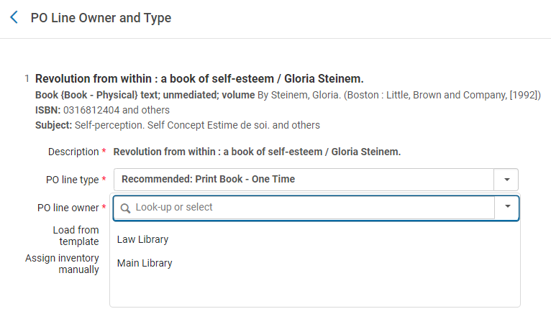
Scope of the staff user role "Purchasing Operator"
This is what staff user Mary Ann Barlow can choose as POL Owner (only libraries that match her Purchasing Operator scope):

Slide 16
Scope of the staff user role "Purchasing Operator"
For example:
Staff user Niki Karimi has Purchasing Operator for the entire institution (Alma University):

Slide 17
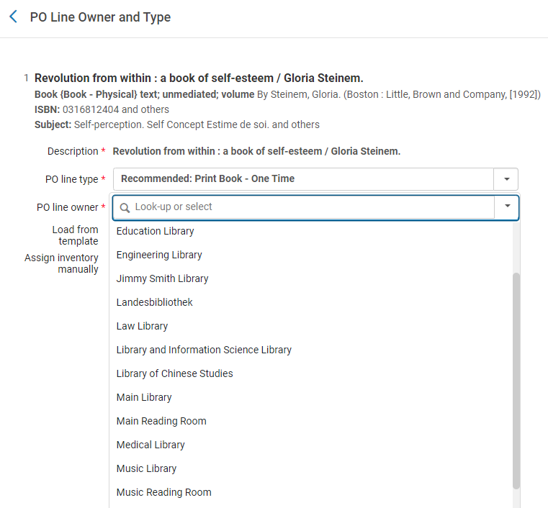
Scope of the staff user role "Purchasing Operator"
This is what staff user Niki Karimi can choose as POL Owner (all libraries because her Purchasing Operator scope in the institution):

Slide 18
Relationships of type "Acquiring For"

Slide 19
Relationships of type "Acquiring For"
The definitions of which libraries can acquire for other libraries is defined in the library relations. For example, in the situation we will look at now:
  The "Main library" is defined to be able to order for (acquire for) the following libraries:
    The Main Library (itself)
    The Art Library
    The Engineering Library
    The Music Library
  The "Law library" is defined to be able to order for (acquire for) the following libraries:
    The Law Library (itself)

Slide 20
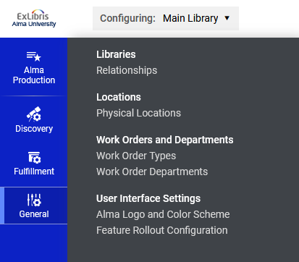
Relationships of type "Acquiring For"
Now we will navigate to "Configuration Menu > Choose on top "Configuring: Main Library" > General > Libraries > Relationships"

Slide 21
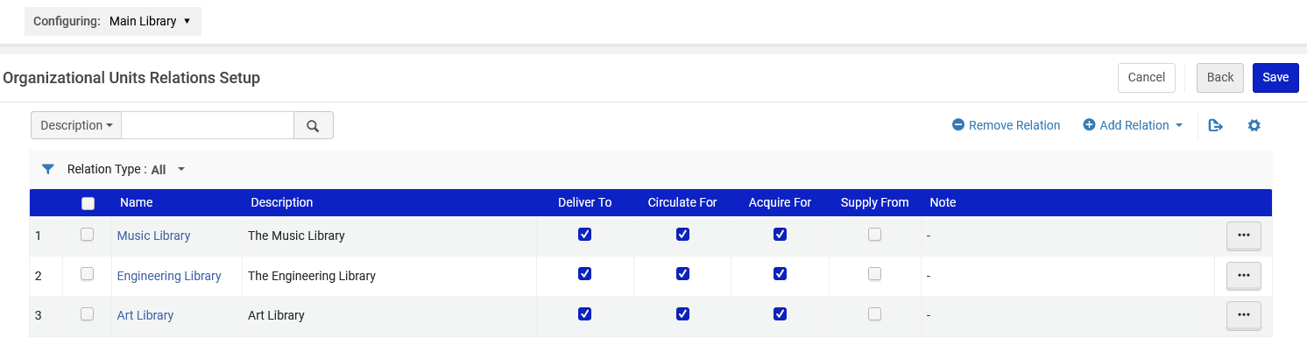
Relationships of type "Acquiring For"
See that it is defined that the Main Library may acquire for the Main Library (itself), the Music Library, the Engineering Library and the Art Library.
We could add another relation here

Slide 22
Relationships of type "Acquiring For"
For example:
If the POL Owner is Main Library, then Inventory may be added for the Main Library as well as those other libraries which are defined as an "Acquire For" relationship with the Main Library.

Slide 23
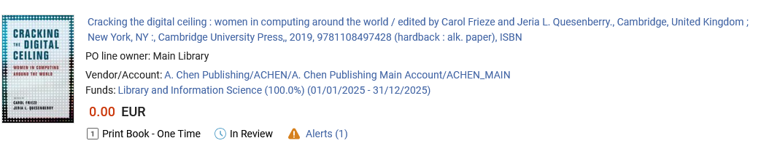
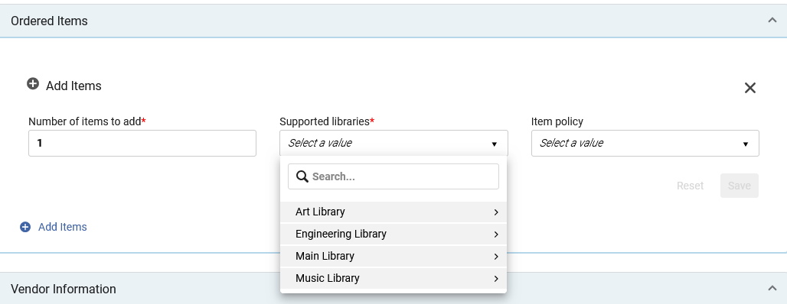
Relationships of type "Acquiring For"
POL Owner is Main Library
Inventory may be added for the Main Library as well as those other libraries which are defined as an "Acquire For" relationship with the Main Library.

Slide 24
Relationships of type "Acquiring For"
The definitions of which libraries can acquire for other libraries is defined in the library relations.
For example, in the situation we will look at now, the "Law library" is defined to be able to order for (acquire for) only itself and not for any other libraries

Slide 25
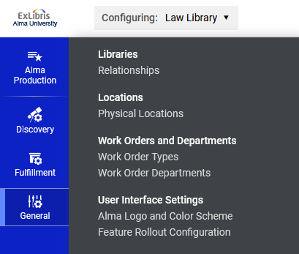
Relationships of type "Acquiring For"
Now we will navigate to "Configuration Menu > Choose on top "Configuring: Law Library" > General > Libraries > Relationships"

Slide 26
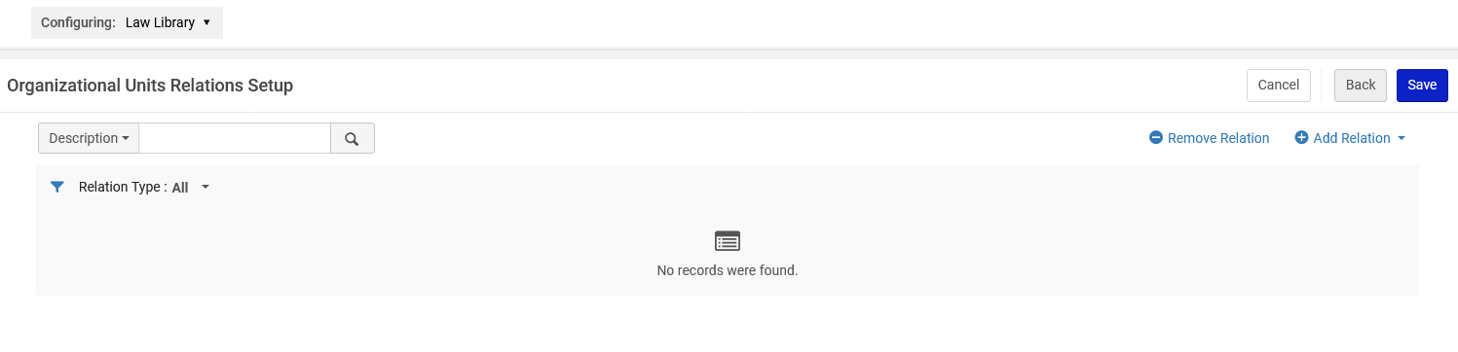
Relationships of type "Acquiring For"
See that it is defined that the Law Library may not acquire for any other libraries.
We could add a relation here

Slide 27
Relationships of type "Acquiring For"
For example:
If the POL Owner is Law Library, then Inventory may be added only for the Law Library and not for any other libraries.

Slide 28

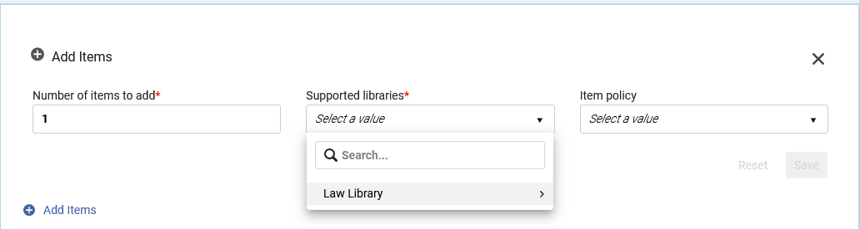
Relationships of type "Acquiring For"
POL Owner is Law Library
Inventory may be added only for the Law Library and not for any other libraries.

Slide 29
Acquisitions Department Served Libraries and Operators

Slide 30
Acquisitions Department Served Libraries and Operators
In order to receive the inventory which has been ordered the staff user must either be at
  An acquisitions department
  A circulation desk which supports an acquisitions work order
In both cases the logic is very similar, and in this presentation we will discuss being at an acquisitions department.
The "served libraries" of the acquisitions department determine which library's or libraries' inventory may be received while at the department.

Slide 31
Acquisitions Department Served Libraries and Operators – Example 1

Slide 32
Acquisitions Department Served Libraries and Operators – Example 1
The following setup which we will look at now means that:
  Staff can be at the "Main Library - Acquisitions Department".
  If staff user Sarah Khan is at the "Main Library - Acquisitions Department" and does "Acquisitions > Receiving and Invoicing > Receive" she will be able to receive inventory for any of the following libraries and not for any other libraries:
    The Main Library
    The Art Library
    The Engineering Library
    The Music Library

Slide 33
Acquisitions Department Served Libraries and Operators – Example 1
For example, in the situation here in this presentation the "Main library Acquisitions Department" is defined to be able to receive inventory belonging to the following libraries:
  The Main Library (itself)
  The Art Library
  The Engineering Library
  The Music Library

Slide 34
Acquisitions Department Served Libraries and Operators – Example 1
Now we will navigate to "Configuration Menu > > Choose on top "Configuring: Main Library" > General > Work Orders and Departments > Work Order Departments"

Slide 35
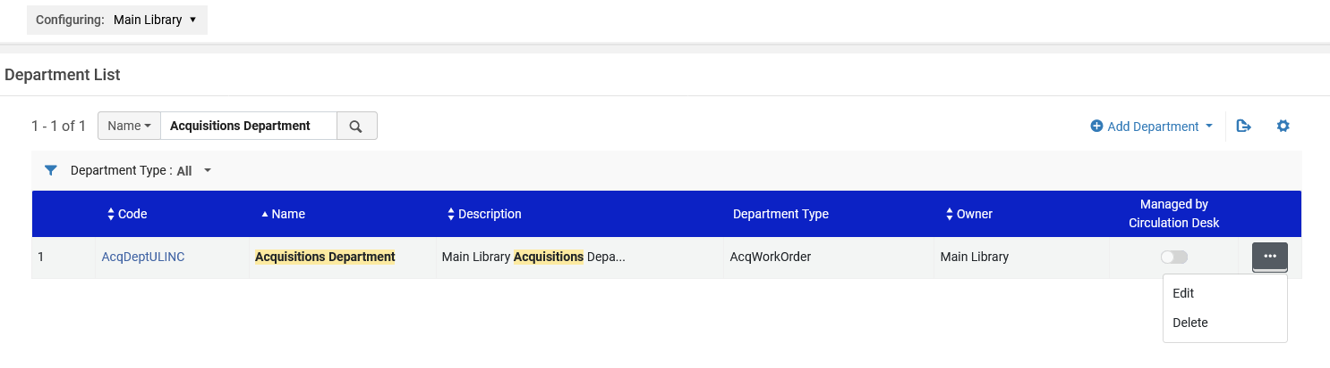
Acquisitions Department Served Libraries and Operators – Example 1
We will edit the "Main library Acquisitions Department"

Slide 36
Acquisitions Department Served Libraries and Operators – Example 1
See that it is defined that the "Served Libraries" are:
  The Main Library (itself)
  The Art Library
  The Engineering Library
  The Music Library

Slide 37
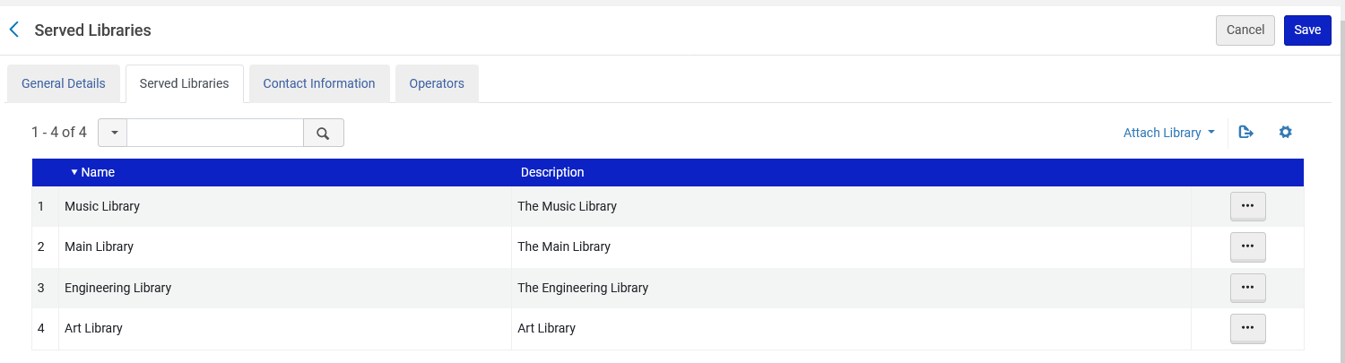
Acquisitions Department Served Libraries and Operators – Example 1

Slide 38
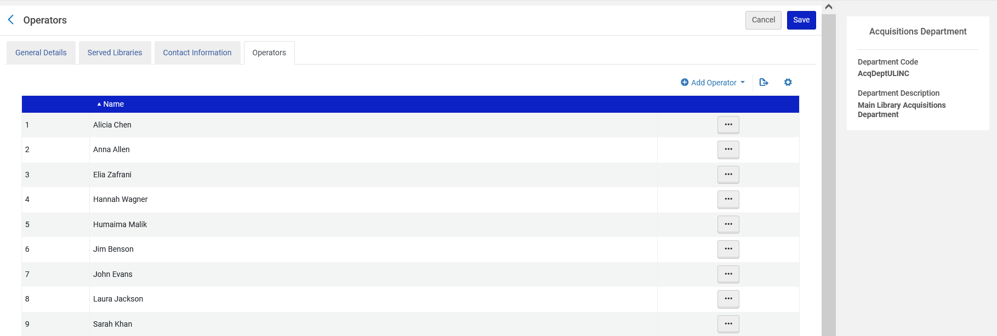
Acquisitions Department Served Libraries and Operators – Example 1
For example, Sarah Khan is an operator in the Main Library Acquisitions Department

Slide 39
Acquisitions Department Served Libraries and Operators – Example 1
If a user is an operator in an acquisitions department, then in the list of roles they will appear as
Role: Receiving Operator
Scope: The Library of the acquisitions department
Service Unit: Acquisitions Department

Slide 40
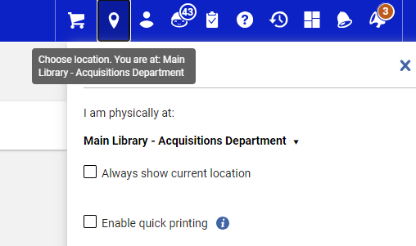
Acquisitions Department Served Libraries and Operators – Example 1
Sarah Khan logs into Alma and is at the Main Library Acquisitions Department.

Slide 41
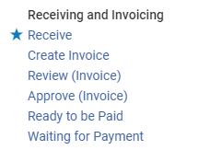
Acquisitions Department Served Libraries and Operators – Example 1
Sarah Khan accesses "Acquisitions > Receiving and Invoicing > Receive"

Slide 42
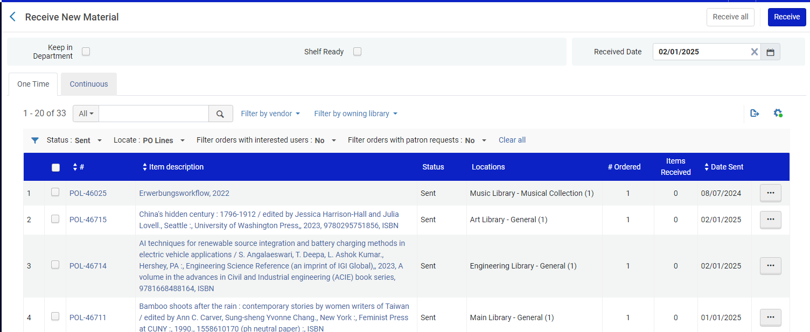
Acquisitions Department Served Libraries and Operators – Example 1
At the Main Library Acquisitions Department Sarah Khan can receive items for the Main Library, Art Library, Engineering Library and Music Library (and not for other libraries)

Slide 43
Acquisitions Department Served Libraries and Operators – Example 2

Slide 44
Acquisitions Department Served Libraries and Operators – Example 2
The following setup which we will look at now means that:
  Staff can be at the "Law Library - Acquisitions Department".
  If staff user Maya Ali is at the "Law Library - Acquisitions Department" and does "Acquisitions > Receiving and Invoicing > Receive" she will be able to receive inventory for any of the following libraries and not for any other libraries:
    The Law Library
In other words: The "Law Library - Acquisitions Department" can receive inventory only from the Law Library and not from any other libraries.

Slide 45
Acquisitions Department Served Libraries and Operators – Example 2
For example, in the situation here in this presentation the "Law library Acquisitions Department" is defined to be able to receive inventory belonging to the following libraries:
  The Law Library (itself)

Slide 46
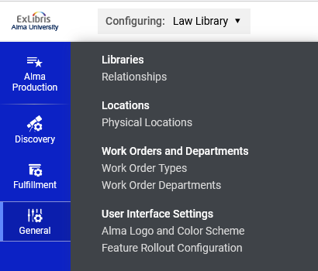
Acquisitions Department Served Libraries and Operators – Example 2
Now we will navigate to "Configuration Menu > > Choose on top "Configuring: Law Library" > General > Work Orders and Departments > Work Order Departments"

Slide 47
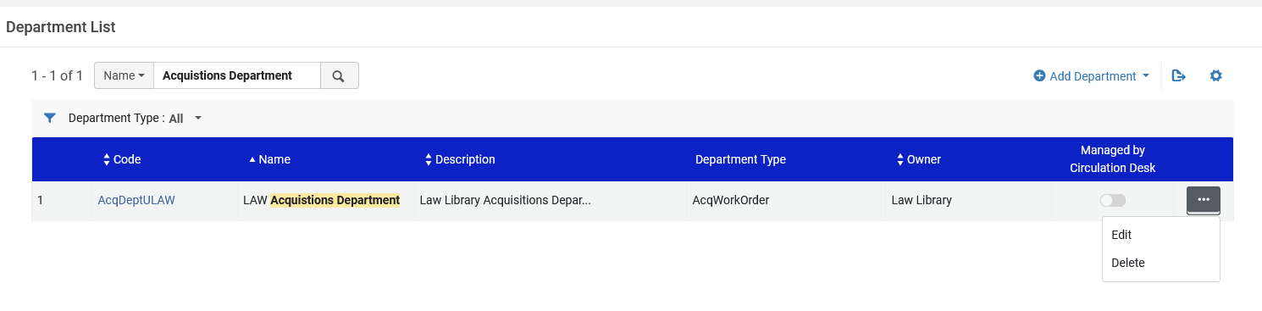
Acquisitions Department Served Libraries and Operators – Example 2
We will edit the "Law library Acquisitions Department"

Slide 48
Acquisitions Department Served Libraries and Operators – Example 2
See that it is defined that the "Served Libraries" are:
  The Law Library (itself)

Slide 49
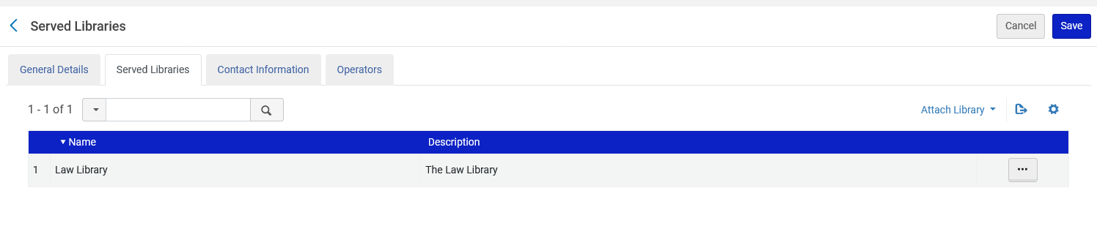
Acquisitions Department Served Libraries and Operators – Example 2

Slide 50
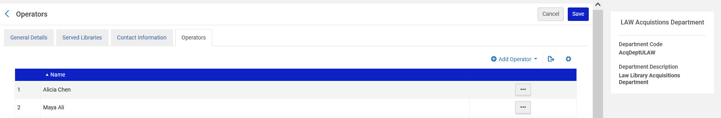
Acquisitions Department Served Libraries and Operators – Example 2
For example, Maya Ali is an operator in the Law Library Acquisitions Department

Slide 51
Acquisitions Department Served Libraries and Operators – Example 2
If a user is an operator in an acquisitions department, then in the list of roles they will appear as
Role: Receiving Operator
Scope: The Library of the acquisitions department
Service Unit: Acquisitions Department

Slide 52
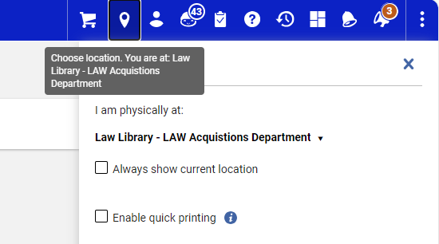
Acquisitions Department Served Libraries and Operators – Example 2
Maya Ali logs into Alma and is at the Law Library Acquisitions Department.

Slide 53
Acquisitions Department Served Libraries and Operators – Example 2
Maya Ali accesses "Acquisitions > Receiving and Invoicing > Receive"

Slide 54
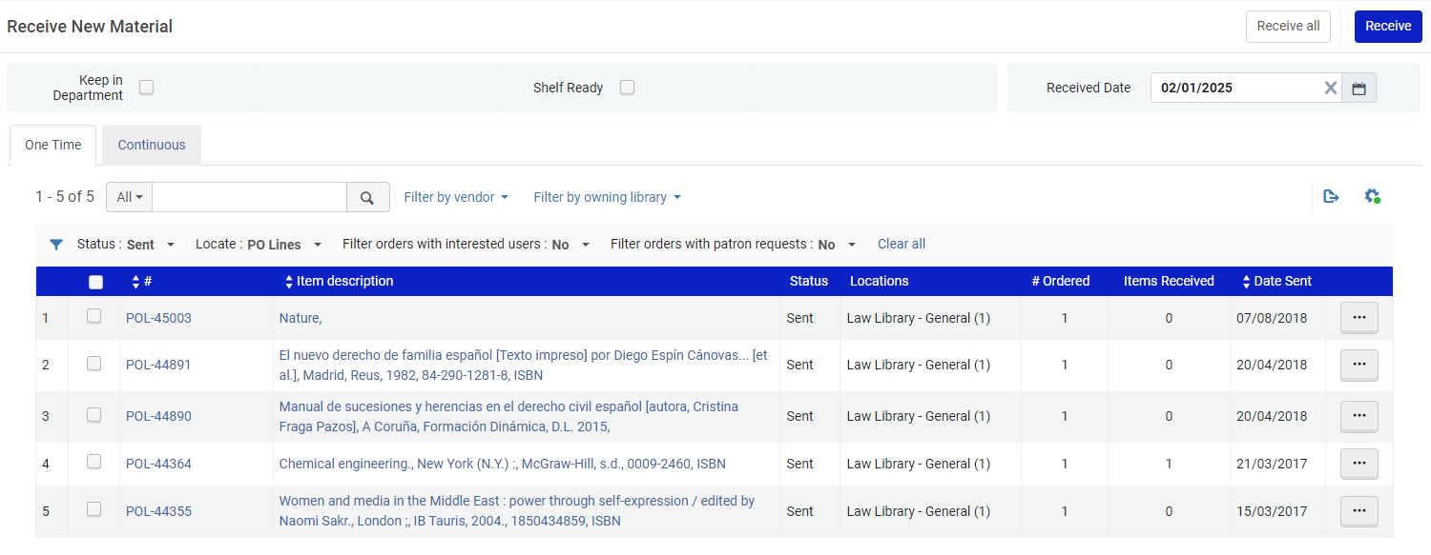
Acquisitions Department Served Libraries and Operators – Example 2
At the Law Library Acquisitions Department Maya Alia can receive items for the Law Library (and not for other libraries)

Slide 55
xxx@exlibrisgroup.com

